Slide 1

Feasibility Testing Review
Nikolai DiLullo, Alexandra Friebolin, Alexia Hnatowicz, Jacob Morrissette, Joseph Sedutto
October 16, 2025

Slide 2



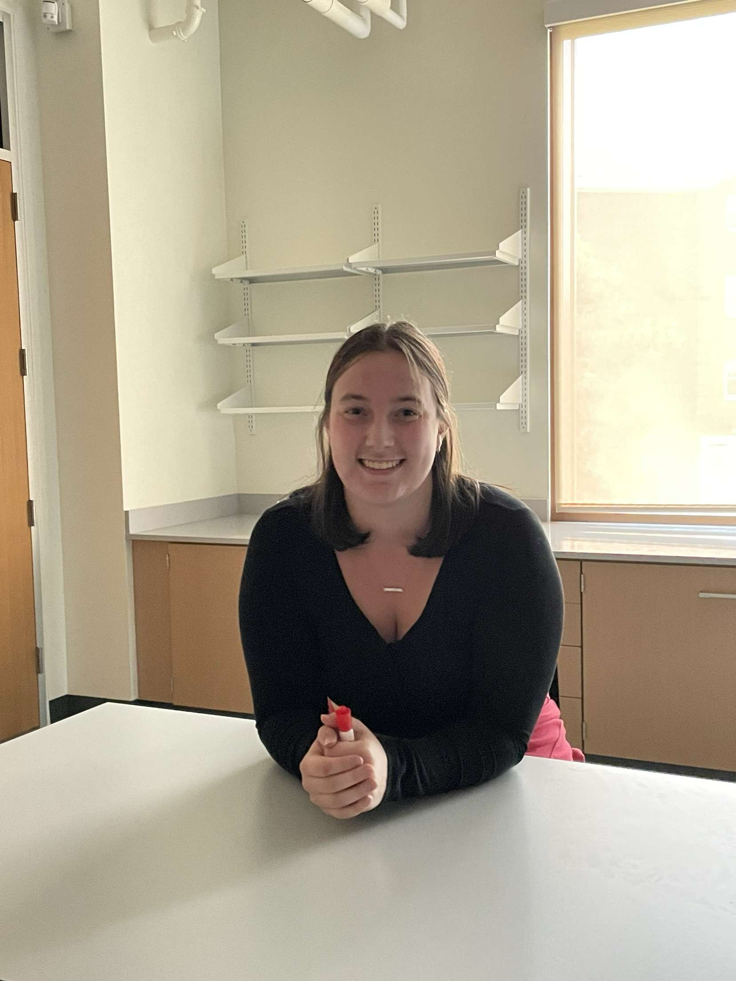

Project Team & Roles
Alexandra Friebolin
Program Lead
(M.E.)
Jacob Morrissette
Chief Test Engineer
(M.E.)
Nik DiLullo
Chief Analyst
(E.E.)
Joe Sedutto
Systems Engineer
(E.E.)
Alexia Hnatowicz
Project Engineer
(M.E.)

Slide 3
Agenda
01
System Overview
02
Critical Areas of Evaluation
03
Supply Chain Capability
04
Component Performance
05
Control System Quality
06
Project Budget
07
Next Steps

Slide 4
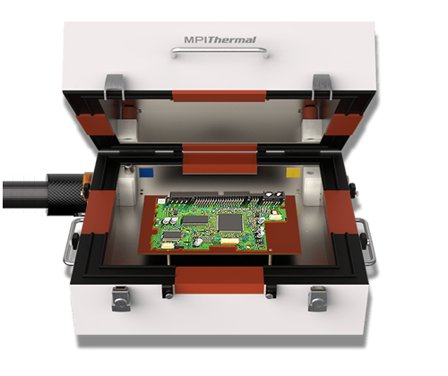
System Overview
Thermally-controlled Printed Circuit Board (“PCB”) testing chamber
Table-top system
User-control & automatic operation
Spanning 0C – 70C commercial temperature range
Purpose: evaluating operation, functionality, & performance of electronic components in real-world simulated conditions
Notes:
Overall description PCB testing chamber, lives on a tabletop. Has software and Hardware components to control the internal enviornement

Slide 5




Critical Areas of Evaluation
Supply Chain Capability
Component Performance
Control System Quality
Ensuring engineering design process is efficient and successful
Design
Fabrication
Testing
Analysis
Optimization
Implementation

Slide 6


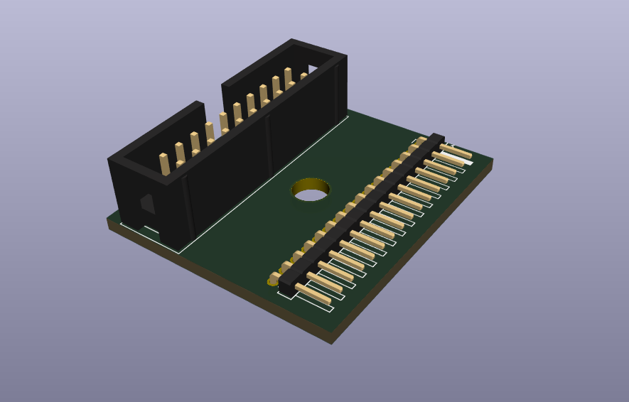
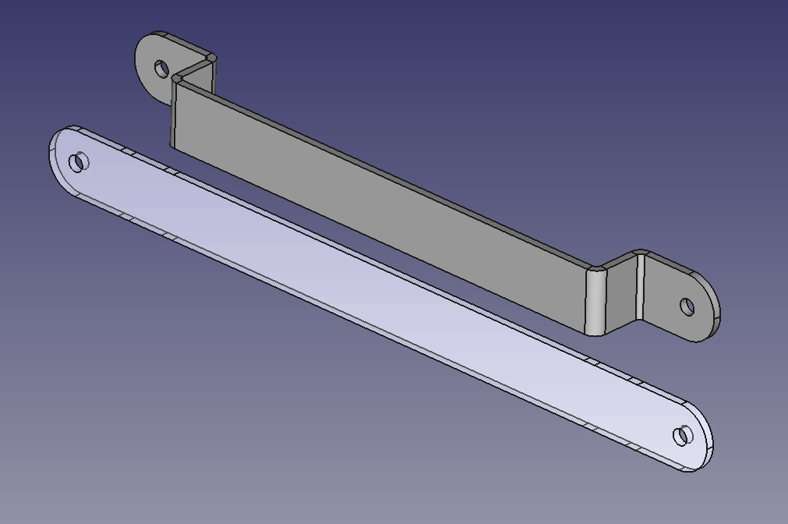
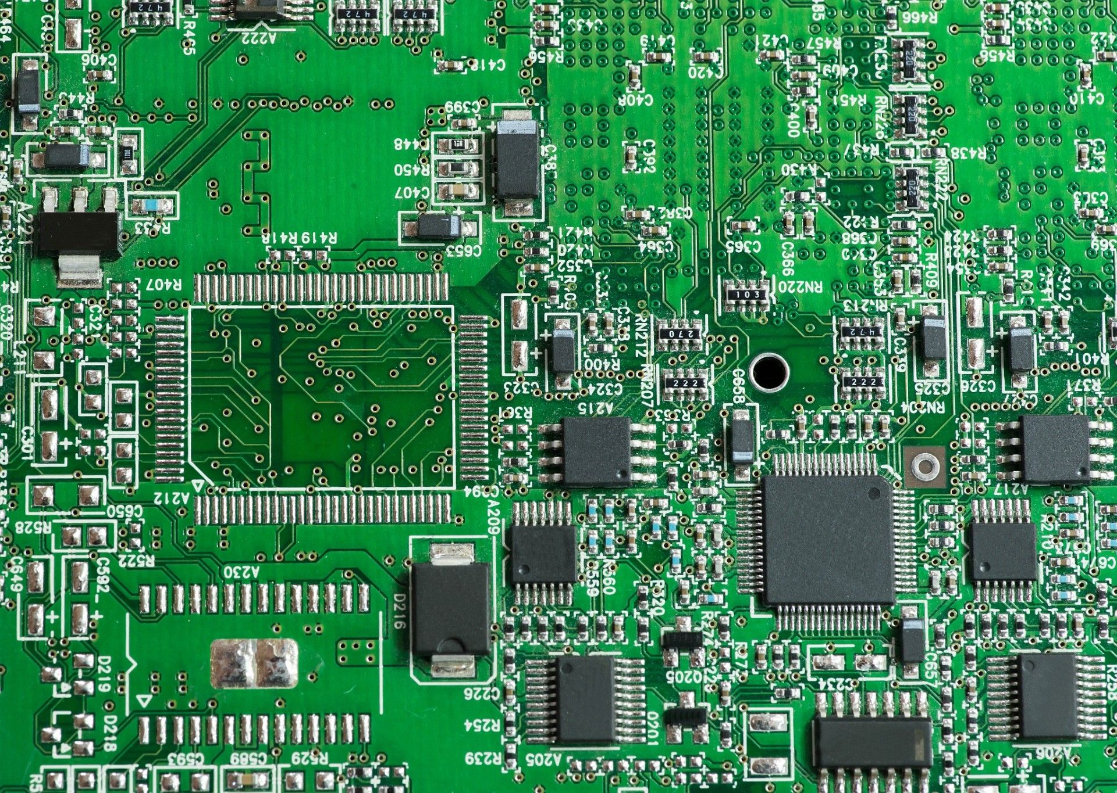

Supply Chain Capability
Objective(s):
To evaluate effectiveness & efficiency of logistics for sourcing materials
Test Article(s):
PCB prototype & mechanical structural part
Data to be Collected:
Manufacturer lead time, price, company, and product information
Test Support:
N/A
Instrumentation:
Computer → CAD, product order, & communication
Success Criteria:
1) Component arrives within 2 weeks from initial order
2) Component arrives with 0 defects hindering operation or performance
3) Component matches design dimensions
4) Supplier provides solid support services

Slide 7
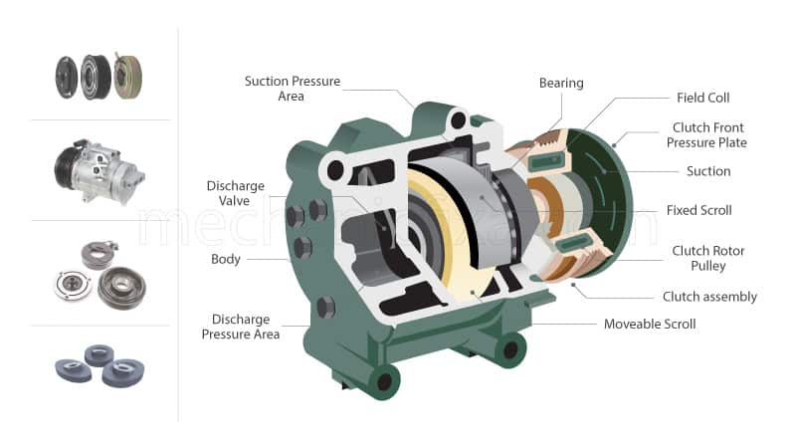
Component Performance
Objective(s):
To verify simultaneous operation of compressor with controller, and confirm performance meets initial system requirements
Test Article(s):
Compressor component
Data to be Collected:
Component reliability, capable operating temperature range, power consumption, and heat transfer rate
Test Support:
Table with fixture accommodating compressor and ancillary parts
Instrumentation:
Supporting wiring and electrical components for compressor operation
Success Criteria:
1) Compressor functions properly for a continuous 1hr operating period
2) Effective minimum temperature reaches ≤0C
3) Compressor operates successfully when given ≥5 varying thermal setpoints within 1hr

Slide 8
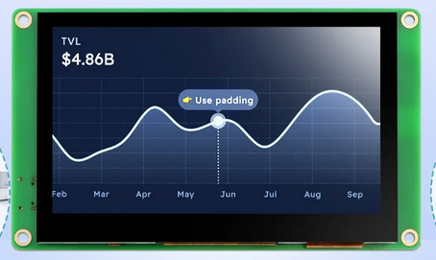
Control System Quality
Objective(s):
To verify Human Machine Interface (“HMI”) screen performs as designed, and the control process from HMI to external wiring functions as predicted
Test Article(s):
HMI screen prototype with touch display and software
Data to be Collected:
Response time to user input, touch accuracy/sensitivity, user-friendliness/readability, system errors, and power consumption
Test Support:
Table with fixture accommodating HMI, lab with sufficient power supply, controlled lighting environment, and communication cable(s)
Instrumentation:
Oscilloscope (signal stability), data acquisition device / computer (monitoring/logging data), camera (system response), multimeter (electrical draw)
Success Criteria:
1) No system freezes or input lag (≥500ms over a continuous 1hr operating period)
2) HMI is highly responsive (≤500ms user-input touch to system feedback)
3) Display readability maintained at ≥75% under all test lighting conditions
4) Power draw within ±10% of HMI design specification

Slide 9
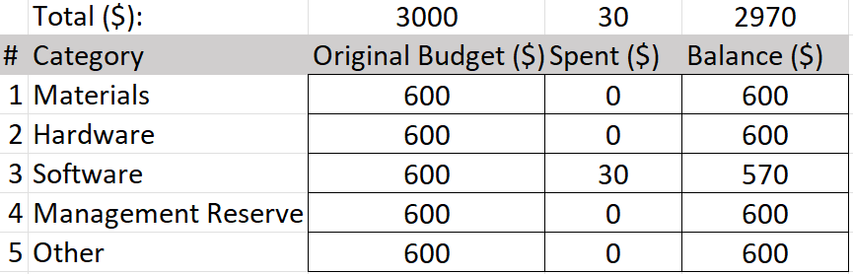
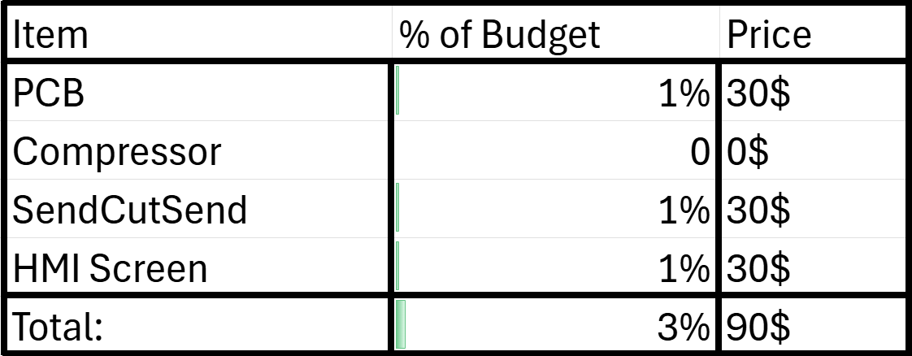
Budget:
Current:
Post-Feasibility Tests:

Slide 10

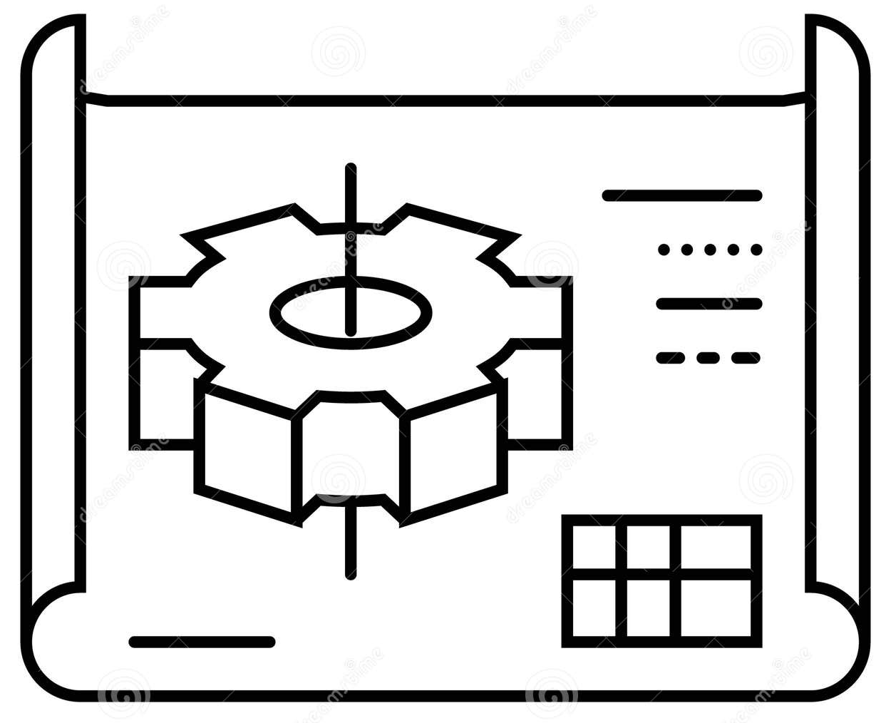

Next Steps
1) Performing feasibility tests
2) Developing design
3) Preliminary design review

Slide 11

Questions?
Our Website
2500 North River Road
Manchester, NH 03106
603.xxx.xxx
snhu.edu

